Slide 1
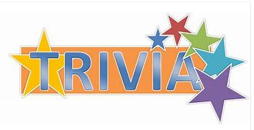
Lets Play

Slide 2
Who is the founding
father of the IBEW?

Slide 3
Henry Miller is our founding father.

Slide 4
How many districts
are in the IBEW?

Slide 5
10 + Canada http://www.ibew.org/

Slide 6
Who is the treasurer
of the IBEW?

Slide 7
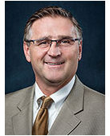
Kenny Cooper

Slide 8
Can you name the
states that make up
District 7?

Slide 9
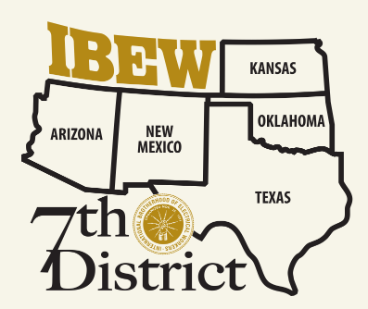
Kansas
Oklahoma
Texas
Arizona
New Mexico

Slide 10
Where is the IBEW museum?

Slide 11
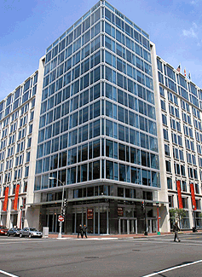
IO office, 900 7th Street NW, Washington DC 20001

Slide 12
Where is the
Henry Miller Museum?

Slide 13
2726 Dr Martin Luther King Dr, St Louis Mo 63106
https://www.bing.com/videos/search?q=henry+miller+museum+st+louis&&view=detail&mid=20D306E3D313257FBC6020D306E3D313257FBC60&&FORM=VRDGAR&ru=%2Fvideos%2Fsearch%3Fq%3Dhenry%2520miller%2520museum%2520st%2520louis%26qs%3DSC%26form%3DQBVDMH%26sp%3D1%26pq%3Dhenry%2520miller%2520museum%2520in%2520st%2520louis%26sc%3D2-31%26cvid%3D73839CB7C77A49398084412C9343E608

Slide 14
Name the trades
The IBEW represents.

Slide 15
Construction
Broadcasting
Railroad
Government
Manufacturing
Telecommunications
and Utilities

